Slide 1
Event Management System
Group Members: Njoroge Gerald Kiragu- 1049402
Njiru Wangeci- 1062451
Kigotho James- 1062069
Omanga Billington George- 1049442
Morine Njenga- 1034016
Course: CMT 302: Advanced Database
Institution: The Catholic University of Eastern Africa
Date: 21 November 2024

Slide 2
Table of Contents
1.0 Introduction
2.0 System Design
3.0 Implementation
4.0 Testing and Validation
5.0 Conclusion and Recommendations
6.0 References
7.0 Appendices

Slide 3
1.0 Introduction

Slide 4
1.1 Overview
The Event Management System (EMS) has been developed to address the management of events more specifically, event management schedules, bookings, and attendees.
This project relies on MySQL to create a robust back-end database for the efficient operational performance of critical activities
1.2 Rationale
Event data handling is critical in modern event planning. Manual processes are prone to errors.
An event management system helps minimize the number of errors and allow for real-time information processing
1.3 Objectives
Objectives include: 1. Designing a robust database 2. Implementing CRUD operations 3. Ensure data consistency, reliability, and security 4. Design database using MySQL for event management system

Slide 5
2.0 SYSTEM DESIGN

Slide 6
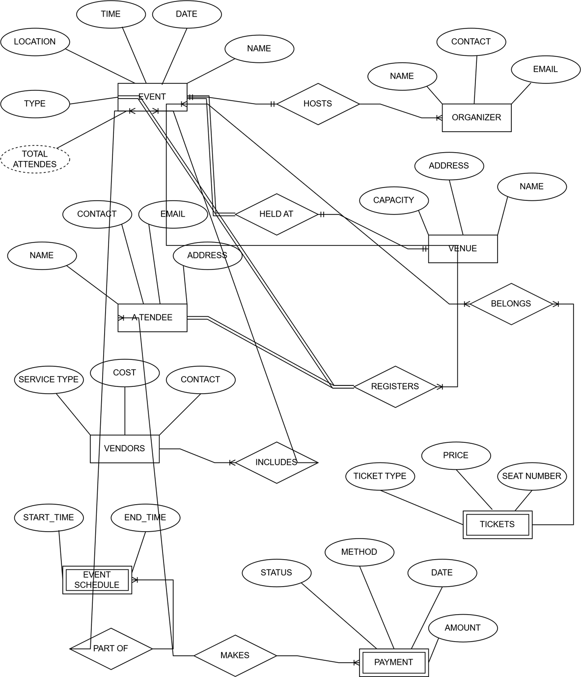
2.1 ERD Diagram
The ERD illustrates the core entities such as Events, Venues, Attendees, Vendors, and Organizers.

Slide 7
2.2 Table Structures
Tables include permissions, tbladmin, tblbooking, tblcompany, and tbleventtype, tblservice
Table Name | Purpose | Primary Key | Key Columns
permissions | Stores user permissions to manage access control. | id | permission: Defines the role (e.g., Superuser, Admin). createuser, deleteuser, createbid, updatebid: Specify the allowed operations.
tbladmin | Manages administrator details and access. | ID | AdminName, UserName, FirstName, LastName: Identify admin users. MobileNumber, Email: Contact information. Password, AdminRegdate: Stores login credentials and registration date.
tblbooking | Contains booking records for various events. | ID | BookingID, ServiceID: Identify specific bookings and associated services. Name, MobileNumber, Email: Customer information. VenueAddress, EventType, AdditionalInformation: Event details.
tblcompany | Holds information about event management companies. | id | regno, companyname, companyemail, companyphone: Company identifiers and contact details. companylogo, companyaddress: Branding and location.
tbleventtype | Lists different types of events managed in the system. | ID | EventType: Specifies the type of event (e.g., Anniversary, Wedding).
tblservice | Stores details about various services offered for events. | ID | ServiceName, SerDes: Name and description of the service. ServicePrice: Cost associated with each service.

Slide 8
2.3 SQL SCHEMA
SQL schemas define the table structures, including the permissions and tbladmin examples below
CREATE TABLE permissions (
id int(11) NOT NULL,
permission varchar(255) CHARACTER SET latin1 NOT NULL,
createuser varchar(255) DEFAULT NULL,
deleteuser varchar(255) DEFAULT NULL,
createbid varchar(255) DEFAULT NULL,
updatebid varchar(255) DEFAULT NULL
);
INSERT INTO permissions (id, permission, createuser, deleteuser, createbid, updatebid)
VALUES
(1, 'Superuser', '1', '1', '1', '1'),
(2, 'Admin', '1', NULL, '1', '1'),
(3, 'User', NULL, NULL, '1', NULL);
CREATE TABLE tbladmin (
ID int(10) NOT NULL,
Staffid varchar(255) DEFAULT NULL,

Slide 9
AdminName varchar(120) DEFAULT NULL,
UserName varchar(120) DEFAULT NULL,
FirstName varchar(255) DEFAULT NULL,
LastName varchar(255) DEFAULT NULL,
MobileNumber bigint(10) DEFAULT NULL,
Email varchar(200) DEFAULT NULL,
Status int(11) NOT NULL DEFAULT '1',
Photo varchar(255) CHARACTER SET latin1 NOT NULL DEFAULT 'avatar15.jpg',
Password varchar(120) DEFAULT NULL,
AdminRegdate timestamp NULL DEFAULT CURRENT_TIMESTAMP
);
INSERT INTO tbladmin (ID, Staffid, AdminName, UserName, FirstName, LastName, MobileNumber, Email, Status, Photo, Password, AdminRegdate)
VALUES
(2, 'U002', 'Admin', 'ndbhalerao91@gmail.com', 'Nikhil', 'Bhalerao', 942397933, 'ndbhalerao91@gmail.com', 1, 'pro4.jpg', '21232f297a57a5a743894a0e4a801fc3', '2022-07-21 10:18:39'),
(28, 'U001', 'Admin', 'Suraj', 'Suraj', 'kale', 942397933, 'Suraj@gmail.com', 0, 'avatar15.jpg', '21232f297a57a5a743894a0e4a801fc3', '2022-07-25 19:45:45');

Slide 10
3.0 IMPLEMENTATION
3.1 CRUD Operations CRUD operations allow data management.
3.2 Advanced SQL Queries The advanced queries showcase the system’s capacity to perform analysis and high-level computations and operations. Which include: -Revenue Statistics by Event Type and Busy Time Slot Analysis
3.3 Stored Procedures and Triggers Procedures automate tasks and triggers enforce rules

Slide 11
4.0 Testing and validation

Slide 12
4.1 Testing Process
Unit Testing : Testing each database component and a particular function well to confirm the expected behavior.
Integration Testing: The combination of different database components is conducted and assessed.
Validation Testing: Checking any business rules and constraints implemented within the database
Stress Testing: measuring the performance of the database in high volumes and use

Slide 13
4.2 Results
Successful Operations: There was correctness of all CRUD operations, Super-user queries offered solutions, transitions of booking statuses were logged as expected, input validation was appropriate, and triggers ran smoothly
Challenges Encountered: Data Type Mismatches which was solved by enhancing the schema with suitable data types. The trigger for Event Time Validation which was solved by replacing TIME or DATETIME fields with appropriate ones for time-related data storage.
Key Outcomes: Logical constraints and business rules were successfully implemented, which could ensure data integrity and security. The database proved very efficient and scalable during stress testing, as multiple operations could be run simultaneously.

Slide 14
5.0 Conclusion and Recommendations
Summary: The event management system, built on robust SQL commands and procedures, effectively handles event scheduling, booking, and administrative tasks. Its layered database structure ensures data integrity and security through role-based access controls and triggers. Rigorous testing validates its functionality and scalability, making it a reliable tool for managing events and meeting business requirements
Recommendations: The system can be further optimised by integrating dynamic reporting tools, user-friendly front-ends, and High security measures. Automating tasks and improving query efficiency can enhance performance and user experience, aligning the system with current technological trends and user needs.

Slide 15
6.0 References
Arcuri, A., & Galeotti, J. P. (2020). Handling SQL Databases in Automated System Test Generation. ACM Transactions on Software Engineering and Methodology, 29(4), 1–31. https://doi.org/10.1145/3391533
Bladen, C., Wilde, N., Kennell, J., & Abson, E. (2022). Events Management. Events Management. https://doi.org/10.4324/9781003102878
Chakraborty, S., & S, A. P. (2024). CRUD Operation on WordPress Database Using C# SQL Client. SSRN Electronic Journal. https://doi.org/10.2139/ssrn.4674837
Donald, M. (2024). Event Management System. Marcdonald.com. https://marcdonald.com/project/event-management-system
Hosen, M. S., Islam, R., Naeem, Z., Folorunso, E. O., Chu, T. S., Mamun, M. A. A., & Orunbon, N. O. (2024). Data-Driven Decision Making: Advanced Database Systems for Business Intelligence. Nanotechnology Perceptions, 20(S3), pp. 687–704. https://doi.org/10.62441/nano-ntp.v20iS3.51
Janemary Thirusanku, & Lo Poh Ai. (2024). Technology Innovation in Event Management. Journal of Advanced Research in Technology and Innovation Management, 10(1), 1–13. https://akademiabaru.com/submit/index.php/jartim/article/view/5299
Mehta, D. (2023, April 27). Database Testing: A Complete Guide With Examples. Testsigma Blog. https://testsigma.com/blog/database-testing/
Mota, D., Neel Zadafiya, & Jinan Fiaidhi. (2020). Spring Framework for Testing. OPAL (Open@LaTrobe) (La Trobe University). https://doi.org/10.36227/techrxiv.12094230.v1
Seelapareddy, H. (2023). Event Management System Event Management System. https://opus.govst.edu/cgi/viewcontent.cgi?article=1629&context=capstones
Vaitkus, A., Merkys, A., & Gražulis, S. (2021). Validation of the Crystallography Open Database using the Crystallographic Information Framework. Journal of Applied Crystallography, 54(2), 661–672. https://doi.org/10.1107/s1600576720016532

Slide 16
7.0 Appendices

Slide 17
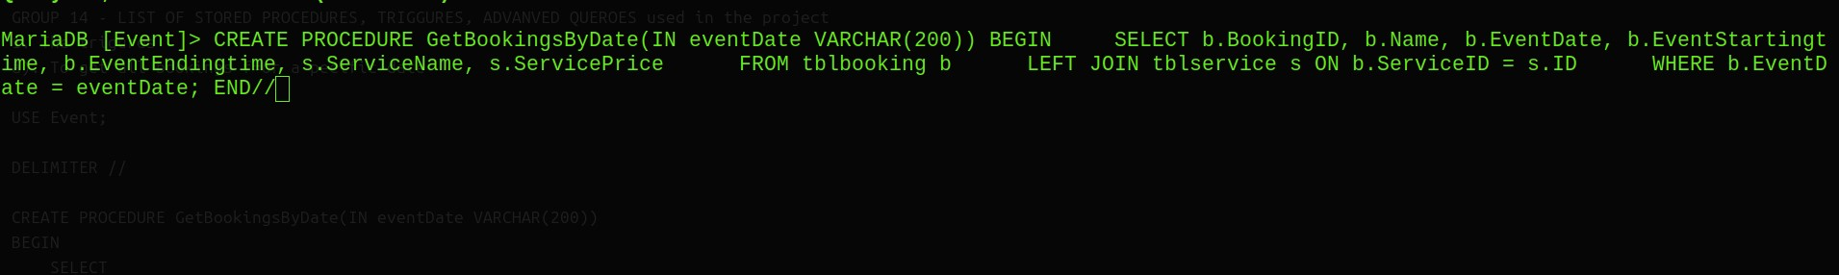
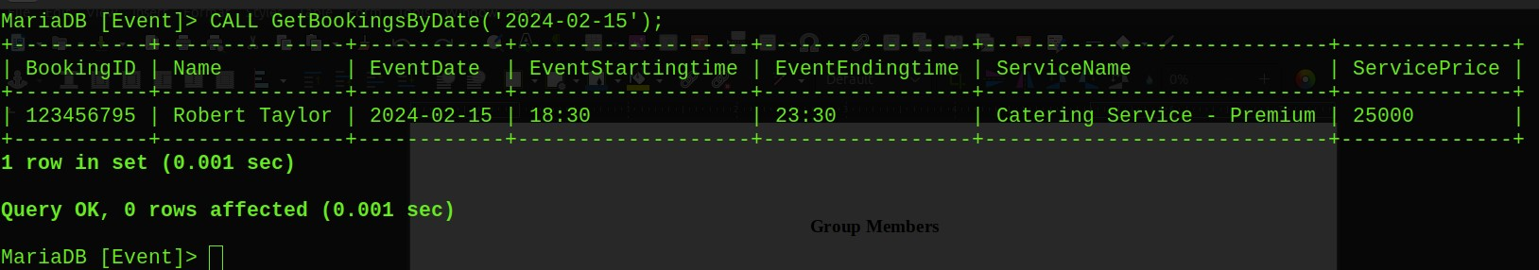
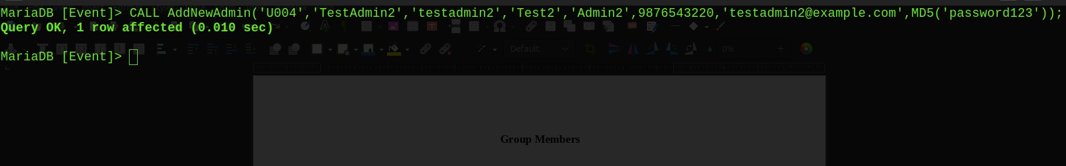
7.1 Stored procedures

Slide 18
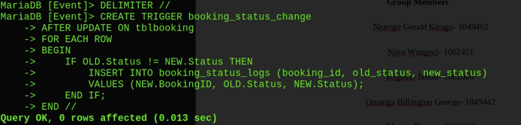
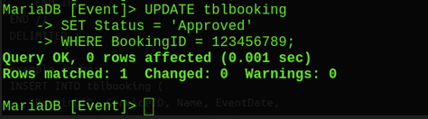
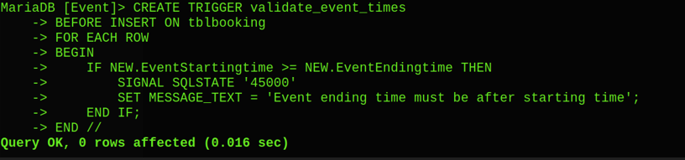
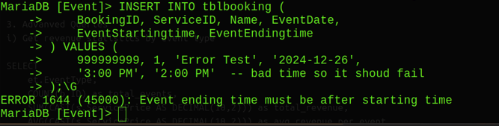
7.2 Triggers
7

Slide 19
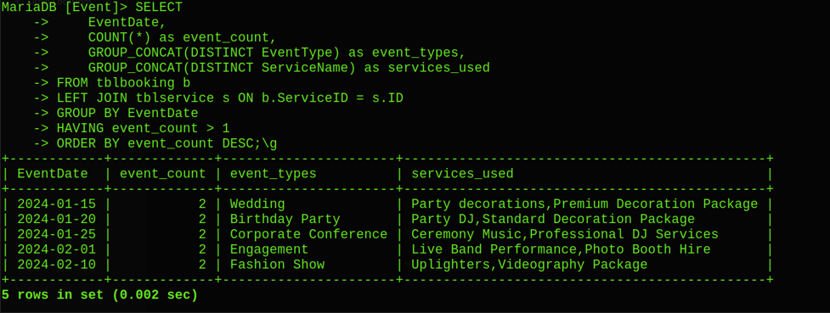
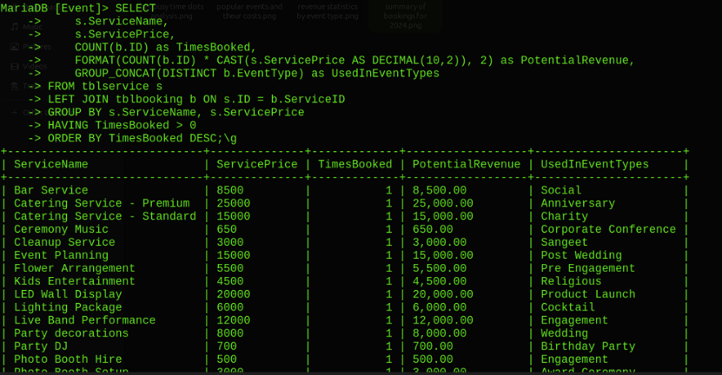
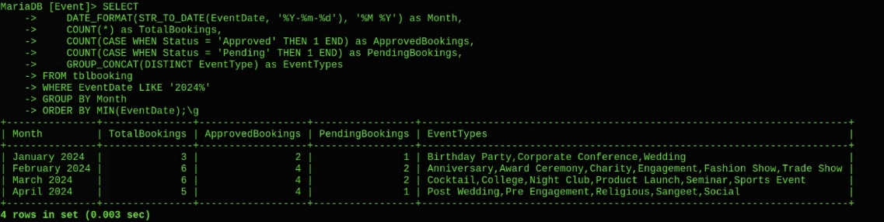
7.3 Advanced queries
7

Slide 20
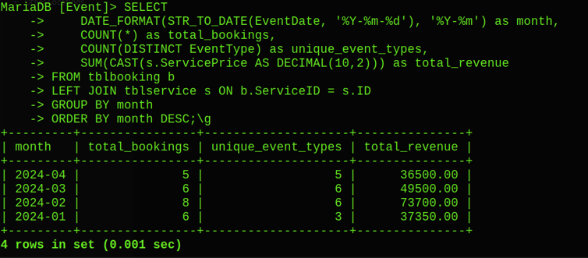
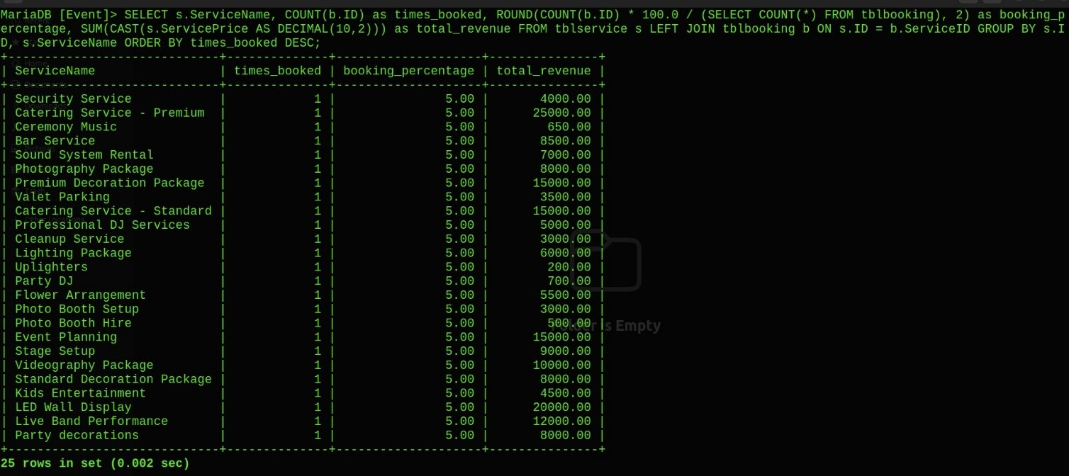
7.4 Reports and views

Slide 21
THANK YOU!

